Slide 1



Time series analysis (Semantic Data Cube)
Michaela Sichert
Email: Michaela.Sichert@stud.sbg.ac.at
09.06.2022
PLUS logo: https://upload.wikimedia.org/wikipedia/
commons/2/2c/Logo_der_Universit%C3%A4t_Salzburg.jpg
ZGIS logo: https://austria-in-space.at/resources/img/logos-organisationen/ unisalzburg.png

Slide 2





Content
Introduction
Earth observation data cubes
Sentinel-2 Semantic Data Cube Austria
Case study
Conclusion

Slide 3
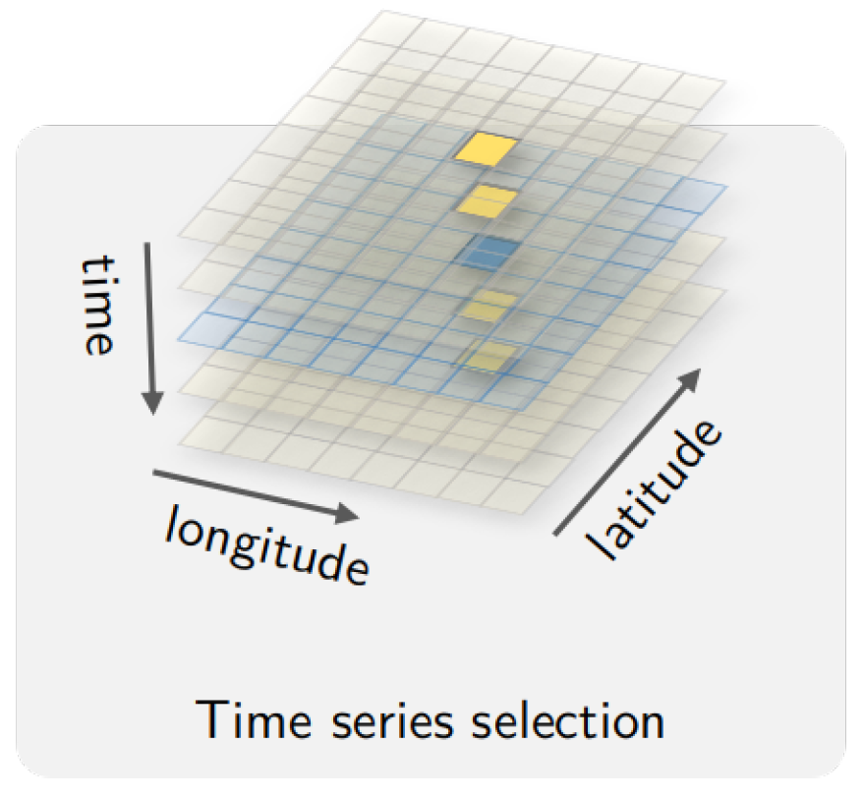
01 Introduction
Time series analysis:
Comparison of the same phenomenon at varying times
Requirement: continuous data series at homologous sites over time
(Simoes et al., 2021)

Slide 4

02 Earth observation data cubes
State-of-the-art EO data cubes:
Organize data within a multi-dimensional structure
Facilitate data storage, access, management and analysis
Feature | File-based EO image hub | State-of-the-art EO data cubes
Image download | ✔ | ✔
Image-wide processing | ✔ | ✔
AOI based processing | ✗ | ✔
Time series analysis (statistical) | ✗ | ✔
(Tiede et al., 2019)

Slide 5
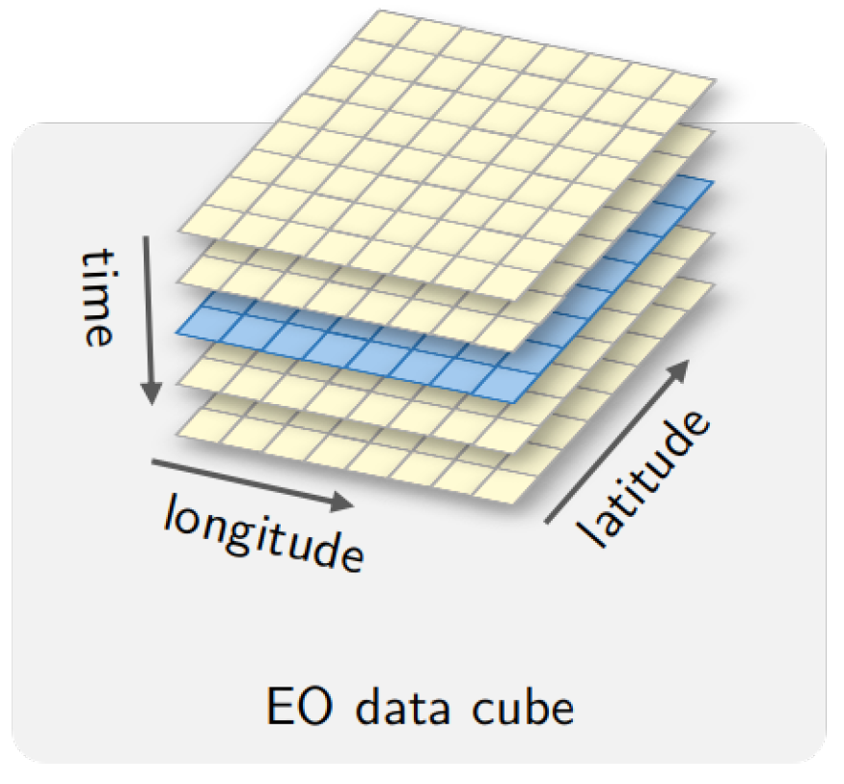
02 Earth observation data cubes
State-of-the-art EO data cubes:
3D construct based on spatial and temporal dimensions
Facilitated data delivery by providing Analysis Ready Data (ARD)
(Simoes et al., 2021)

Slide 6
02 Earth observation data cubes
Semantic EO data cubes:
Advancement of state-of-the-art EO data cubes
Number of EO data is rising but new information is not derived with the same rate
Semantic gap:
Interpretation required since sensor data lack sematic meaning

Slide 7
02 Earth observation data cubes
Semantic EO data cubes:
“A semantic EO data cube […] is a data cube, where for each observation at least one nominal […] interpretation is available and can be queried in the same instance.”
Augustin et al., 2019

Slide 8
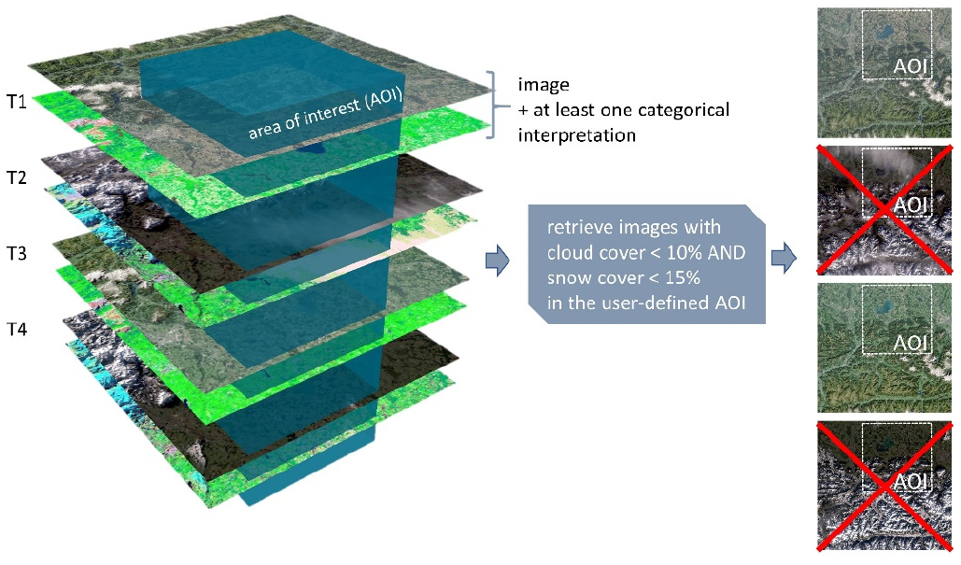
02 Earth observation data cubes
(Augustin et al., 2019)

Slide 9
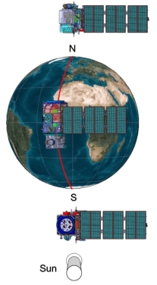
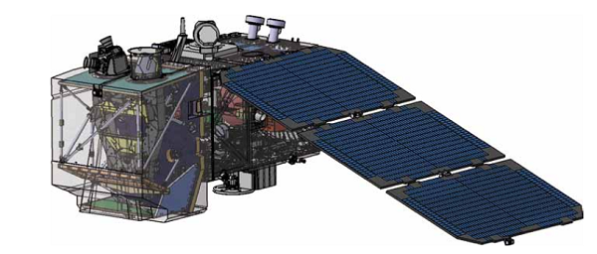

03 Sentinel-2 Semantic Data Cube Austria
Sentinel-2:
WHAT?
WHEN?
WHY?
Constellation of 2 polar orbiting satellites
Sentinel-2A launched in 2015, Sentinel-2B in 2017
Support monitoring of Earth's surface changes
https://sentinel.esa.int/image/image_gallery?uuid=807fffc2-a9c5-4480-a572-27b6bbebf5bd&groupId=247904&t=1347980607743
https://sentinel.esa.int/documents/247904/266366/Sentinel-2_Instrument_Payload_Figure_1v1.png/d4933b4a-45c9-4d6c-9bf5-226ba778b2f7?t=1373923053926

Slide 10

03 Sentinel-2 Semantic Data Cube Austria
Sen2Cube.at:
First operational semantic EO data cube on a national level covering Austria
Enables content-based image search and analysis of all Sentinel-2 images in user-defined regions and time intervals
Image query system accessible as web-application
https://manual.sen2cube.at/img/logo_b.png

Slide 11
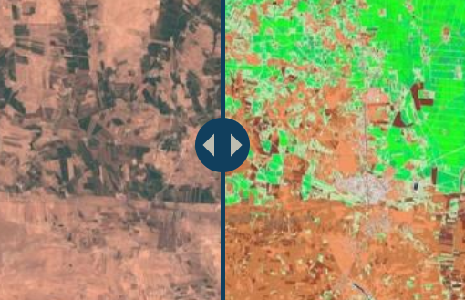
03 Sentinel-2 Semantic Data Cube Austria
Satellite Image Automatic Mapper (SIAM):
User independent expert system
Automated pixel- and spectral rule-based decision-tree classifier assigns multispectral color names to each observation
Sen2Cube.at provides 33 SIAM color names
http://sen2cube.at/

Slide 12

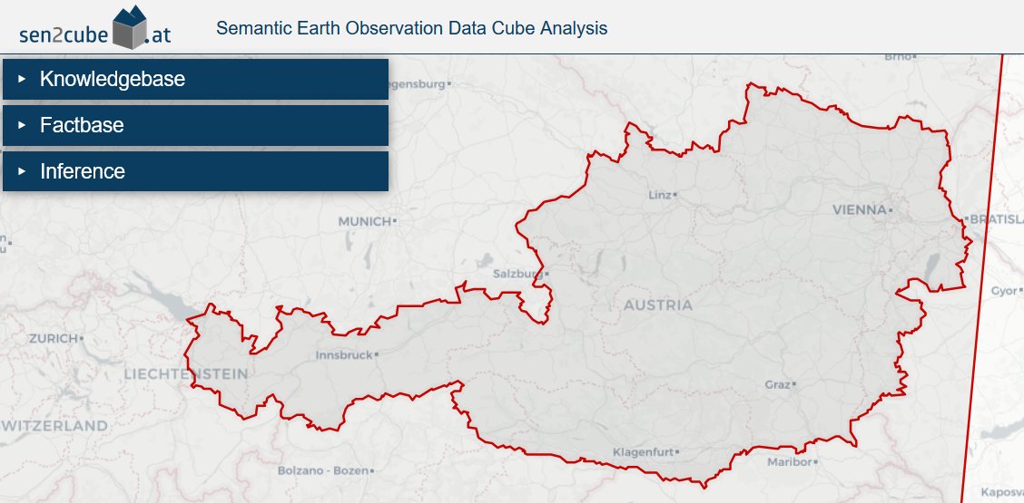
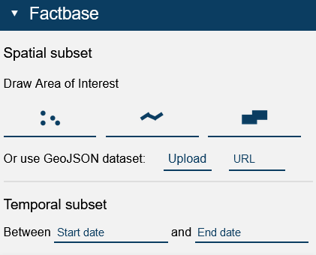
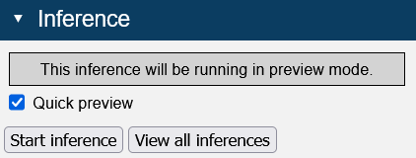
03 Sentinel-2 Semantic Data Cube Austria
Sen2Cube.at: demo.sen2cube.at

Slide 13
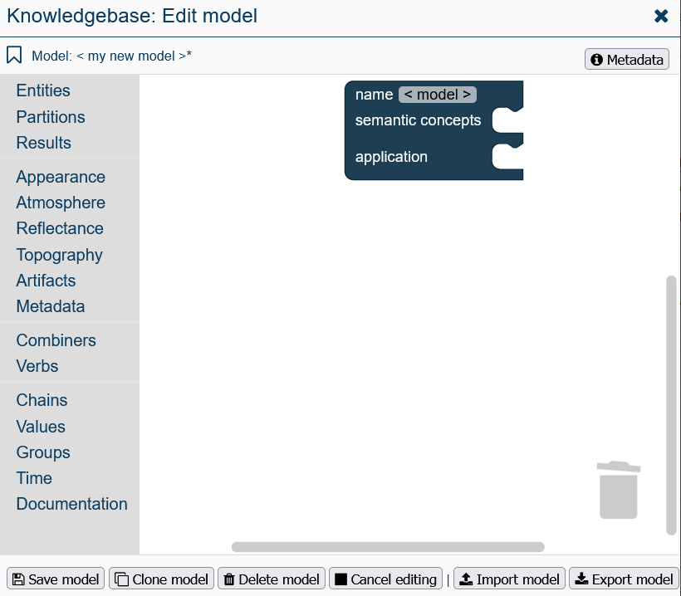
03 Sentinel-2 Semantic Data Cube Austria

Slide 14
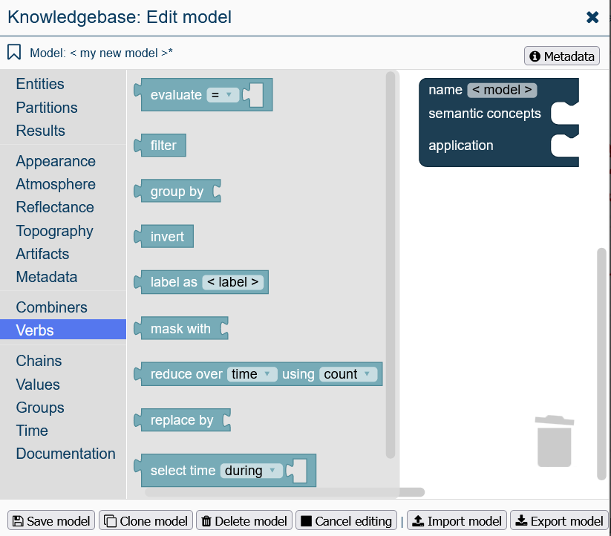
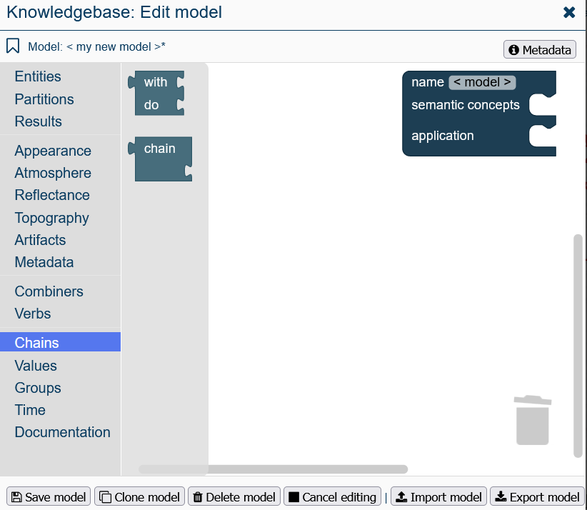

03 Sentinel-2 Semantic Data Cube Austria

Slide 15

03 Sentinel-2 Semantic Data Cube Austria
Important verbs: Mask with
https://manual.sen2cube.at/blocks.html#mask

Slide 16
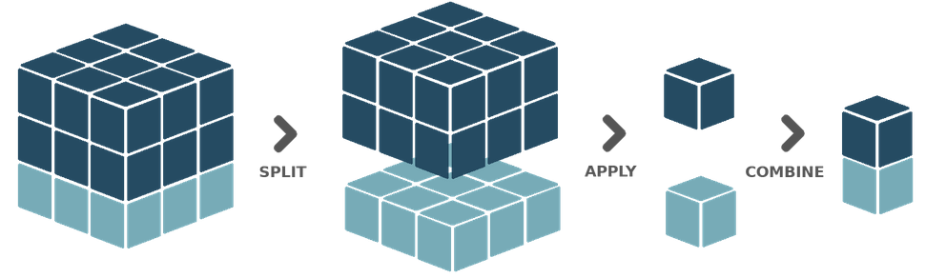
03 Sentinel-2 Semantic Data Cube Austria
Important verbs: Group by & ungroup
https://manual.sen2cube.at/blocks.html#group-by-and-ungroup

Slide 17

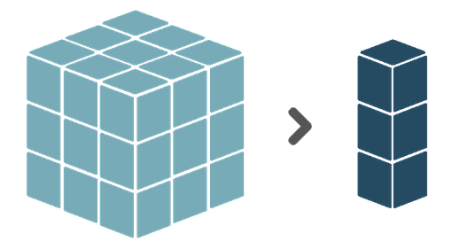
03 Sentinel-2 Semantic Data Cube Austria
Important verbs: Reduce
https://manual.sen2cube.at/blocks.html#reduce

Slide 18
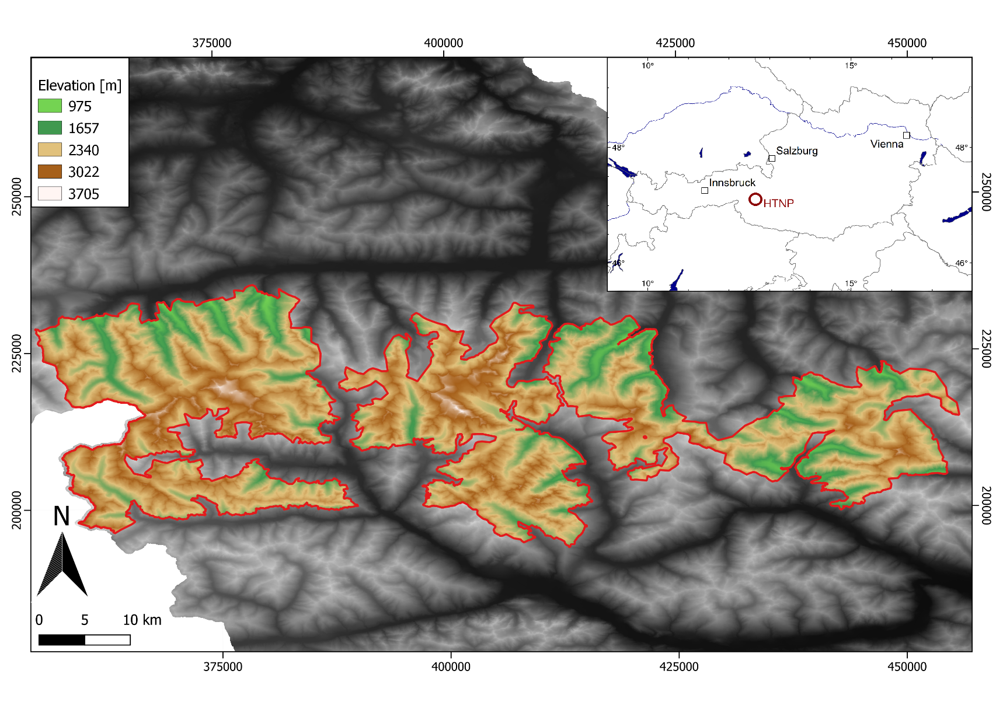

04 Case study
Snow cover time series analysis in the Hohe Tauern National Park (HTNP)

Slide 19
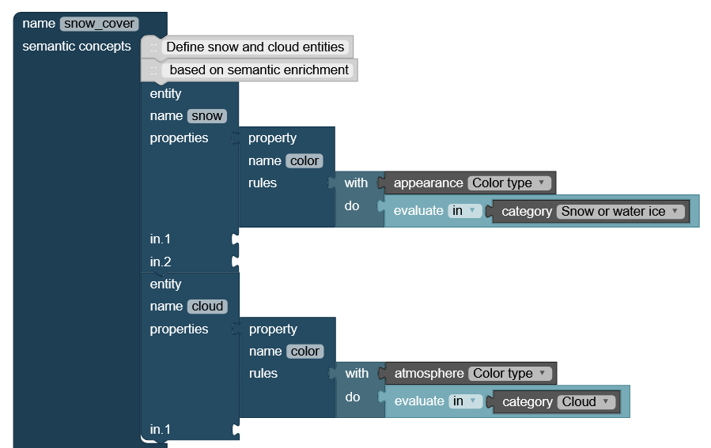
04 Case study
Semantic concepts:

Slide 20
04 Case study
Application: Deriving information about the cloud-free snow cover per year and per month
Delete all observations corresponding to the cloud entity with the ‘mask with’ verb
Group by year and month
Reduction over time

Slide 21
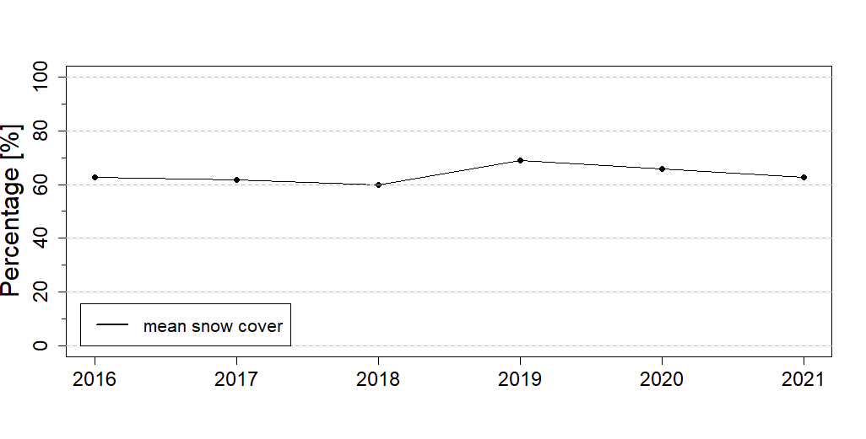
04 Case study
Results:

Slide 22
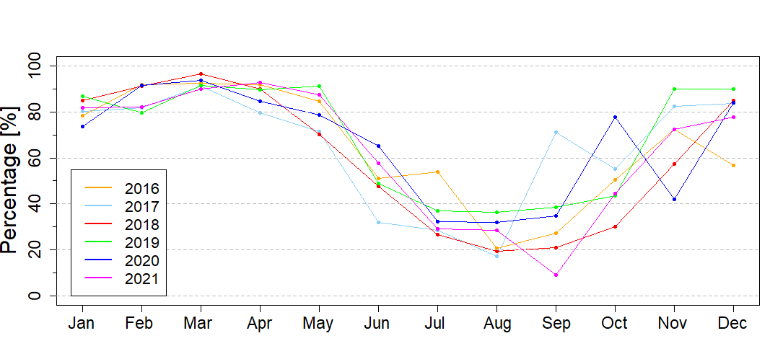
04 Case study
Results:

Slide 23
05 Conclusion
Semantic EO data cubes…
… combine EO data with an interpretation for each observation
… use human-readable semantic queries to automatically derive information
… are the foundation for big EO data expert systems
(Augustin et al., 2019)

Slide 24
References (selection)
AUGUSTIN, H., SUDMANNS, M., TIEDE, D., LANG, S. & BARALDI, A. 2019. Semantic Earth observation data cubes. Data, 4, 102.
MAIN-KNORN, M., PFLUG, B., LOUIS, J., DEBAECKER, V., MÜLLER-WILM, U. & GASCON, F. Sen2Cor for sentinel-2. Image and Signal Processing for Remote Sensing XXIII, 2017. International Society for Optics and Photonics, 1042704.
PHIRI, D., SIMWANDA, M., SALEKIN, S., NYIRENDA, V. R., MURAYAMA, Y. & RANAGALAGE, M. 2020. Sentinel-2 data for land cover/use mapping: A review. Remote Sensing, 12, 2291.
POUSSIN, C., GUIGOZ, Y., PALAZZI, E., TERZAGO, S., CHATENOUX, B. & GIULIANI, G. 2019. Snow Cover Evolution in the Gran Paradiso National Park, Italian Alps, Using the Earth Observation Data Cube. Data, 4, 138.
SIMOES, R., CAMARA, G., QUEIROZ, G., SOUZA, F., ANDRADE, P. R., SANTOS, L., CARVALHO, A. & FERREIRA, K. 2021. Satellite image time series analysis for big earth observation data. Remote Sensing, 13, 2428.
SUDMANNS, M., AUGUSTIN, H., VAN DER MEER, L., BARALDI, A. & TIEDE, D. 2021. The Austrian Semantic EO Data Cube Infrastructure. Remote Sensing, 13, 4807.
SUDMANNS, M., TIEDE, D., LANG, S. & BARALDI, A. 2018. Semantic and syntactic interoperability in online processing of big Earth observation data. International journal of digital earth, 11, 95-112.
SUDMANNS, M., TIEDE, D., LANG, S., BERGSTEDT, H., TROST, G., AUGUSTIN, H., BARALDI, A. & BLASCHKE, T. 2019. Big Earth data: disruptive changes in Earth observation data management and analysis? International Journal of Digital Earth, 13, 832-850.
TIEDE, D., SUDMANNS, M., AUGUSTIN, H., LANG, S. & BARALDI, A. 2019. Sentinel-2 Semantic Data Information Cube Austria. Proceedings of the 2019 Big Data from Space (BiDS’19), Munich, Germany, 19-21.
Z_GIS, Department of Geoinformatics. 2022. Sen2Cube.at Manual [Online]. University of Salzburg. Available: https://manual.sen2cube.at/index.html [Accessed 26.05 2022].

Slide 25

Thank you for your attention!

